Slide 1
Cost aware resource management in distributed cloud data centers
Master Thesis
Technical University of Vienna
Author: Andreas Egger
MatrNr.: 0626885
Supervisor: Univ. Prof. Dr. Ivona Brandic

Slide 2
Overview
Introduction
Main Contributions
Methodological Approach
Forecasting
Simulation Scenario
Results
Conclusion

Slide 3
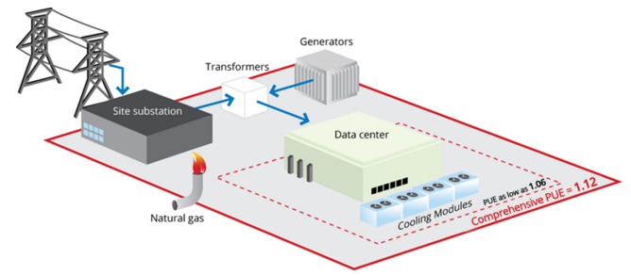
Introduction
Cost optimization in data centers
Improve efficiency
Reduce power consumption
Resource scheduling algorithms
Huge power consumption
1.3% of global electricity use in 2010
198 TWh -> 3 x City of Los Angeles
$9.9B @ 50 $ / MWh
Source: Google Data Center Efficiency [1]
Notes:
Los Angeles Power Consumption 2010 [1]: 68.255 TWh
Population of Los Angeles [2]: 18,550,288
[1] US city power consumption http://ecdms.energy.ca.gov/elecbycounty.aspx
https://www.quora.com/How-much-electricity-does-an-industrialized-city-of-1-million-people-consume
[2] https://en.wikipedia.org/wiki/Demography_of_the_United_States

Slide 4
Introduction
Goals of this thesis
Electricity cost reduction through intelligent resource scheduling
Utilize energy market price volatility to save energy costs
Data analysis of day ahead and real time power markets
Selection of forecasting models to be used for energy price prediction
Simulation of cloud conditions to evaluate cost savings in cloud environments
Definition of a cloud scheduler for handling the trade off between cost reductions and SLA penalties
Provide decision aid for cloud providers for optimal VM migration conditions
Notes:
Los Angeles Power Consumption 2010 [1]: 68.255 TWh
Population of Los Angeles [2]: 18,550,288
[1] US city power consumption http://ecdms.energy.ca.gov/elecbycounty.aspx
https://www.quora.com/How-much-electricity-does-an-industrialized-city-of-1-million-people-consume
[2] https://en.wikipedia.org/wiki/Demography_of_the_United_States

Slide 5
Introduction
Need for energy cost reductions – 2 approaches
Increase energy efficiency
Improve power usage effectiveness (PUE) of data centers
Increase efficiency of data center equipment (servers, cooling system etc.)
Energy efficient servers (low power mode, DVFS)
Energy aware load distribution policies
Reduce electricity costs
Cost and power aware scheduling algorithms
Utilization of energy price differences across power markets
Electricity price forecasting to increase cost savings
Load distribution to reduce cooling costs

Slide 6
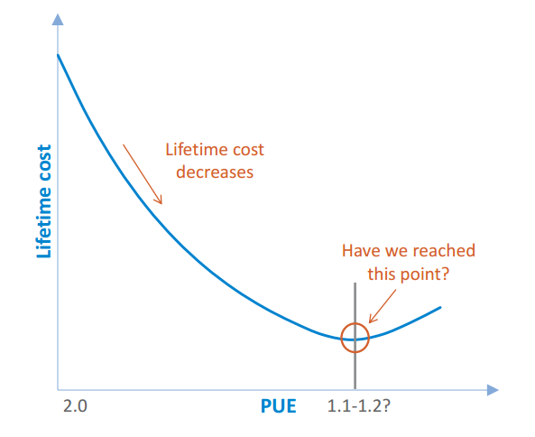
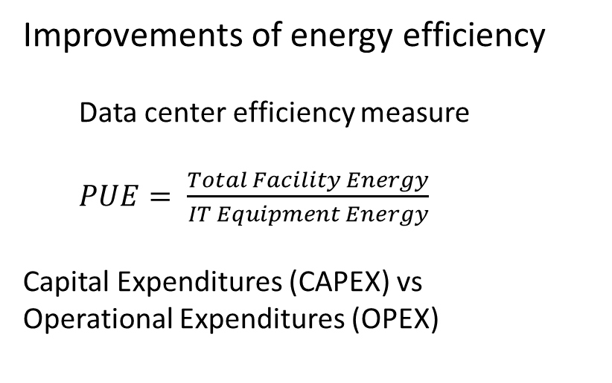
Introduction
Improvements of energy efficiency
Data center efficiency measure
$PUE= \frac{Total Facility Energy}{IT Equipment Energy}$
Capital Expenditures (CAPEX) vs
Operational Expenditures (OPEX)
Source: Data Center Trends [2]

Slide 7
Main Contributions
Framework for cost optimization in Multi Cloud Environments
Decision support for handling VM migrations
Advanced cloud scheduler for handling tradeoff between cost optimization and SLA penalties
Advanced simulation for modeling cloud conditions
Data Analysis of power market data
Forecast model selection based on data
Large scale evaluation of forecasting methods based on electricity price data from various energy markets

Slide 8
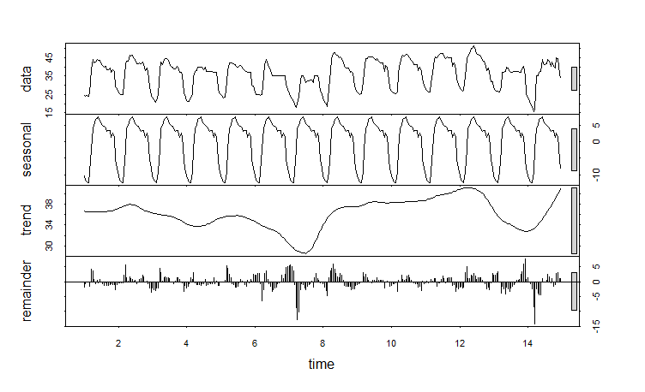
Methodological Approach
Evaluation of energy price data
Day ahead and real time price time series evaluation
Estimate seasonality by frequency analysis
Determine auto correlations in energy price data
Evaluation of energy price characteristics in different energy markets
Estimation of trend, seasonal and cycle components
Two weeks of day ahead price data, July 2014

Slide 9
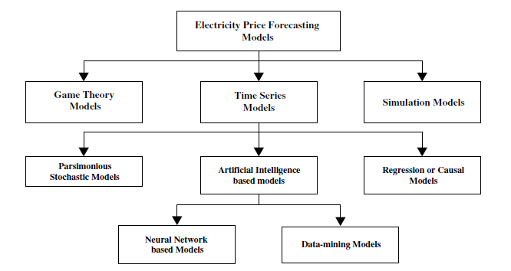
Methodological Approach
Forecast model evaluation
Forecast model classification
Analysis of statistical forecasting models
Source: Classification of price forecasting models [3]

Slide 10
Methodological Approach
Forecast model building
Definition of statistical forecasting models
SES
SES + Trend (Holt)
SES + Trend + Seasonal (HoltWinters)
ARIMA
TBATS (Multiple Seasonality)
Generate ARIMA models based on the Box-Jenkins approach
Populate general class of models (trend and seasonality)
Identify model to be evaluated (model parameters)
Estimate parameters in identified model (maximum likelihood)
Diagnosis checking (model appropriateness)
Apply model to forecasting

Slide 11
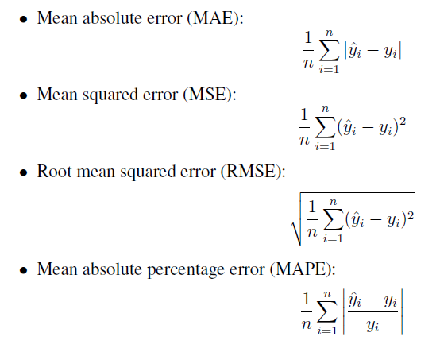
Methodological Approach
Forecast accuracy evaluation

Slide 12
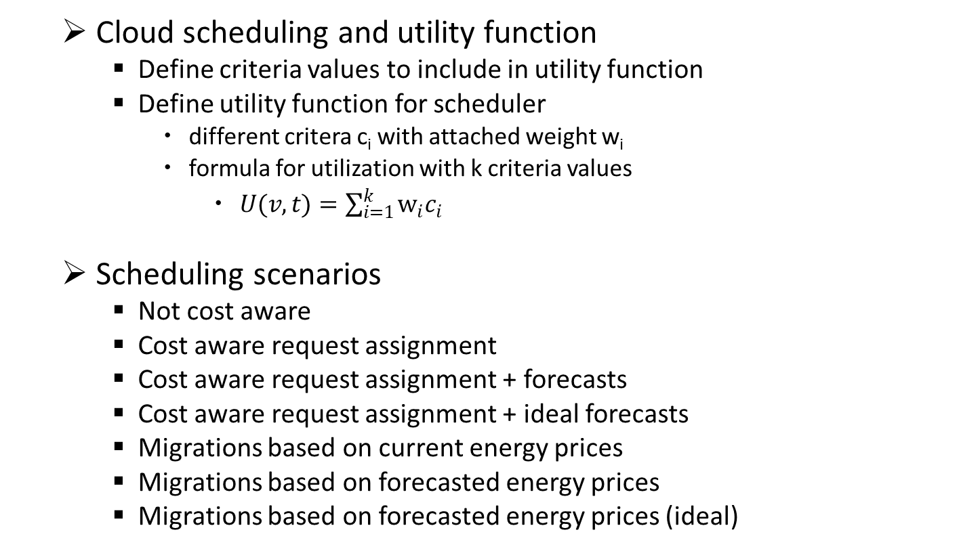
Methodological Approach
Cloud scheduling and utility function
Define criteria values to include in utility function
Define utility function for scheduler
different critera c_{i} with attached weight w_{i}
formula for utilization with k criteria values
$U(v,t)=\sum_{i=1}^{k}{w_{i}c_{i}}$
Scheduling scenarios
Not cost aware
Cost aware request assignment
Cost aware request assignment + forecasts
Cost aware request assignment + ideal forecasts
Migrations based on current energy prices
Migrations based on forecasted energy prices
Migrations based on forecasted energy prices (ideal)

Slide 13
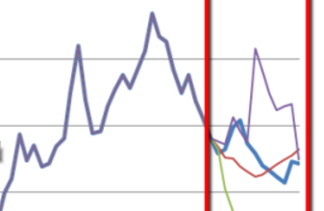
Forecasting
Goals
Build Forecast models for energy price prediction
Suitable for day ahead and real time energy prices
Automated model selection
Large scale forecast model evaluation
Selection of relevant and baseline models
Performance evaluation over extended time range

Slide 14
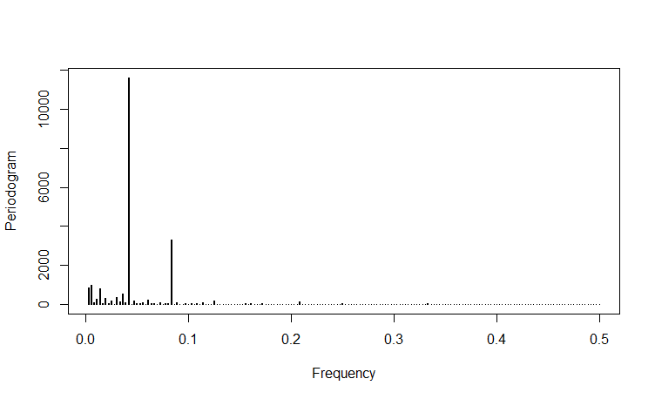
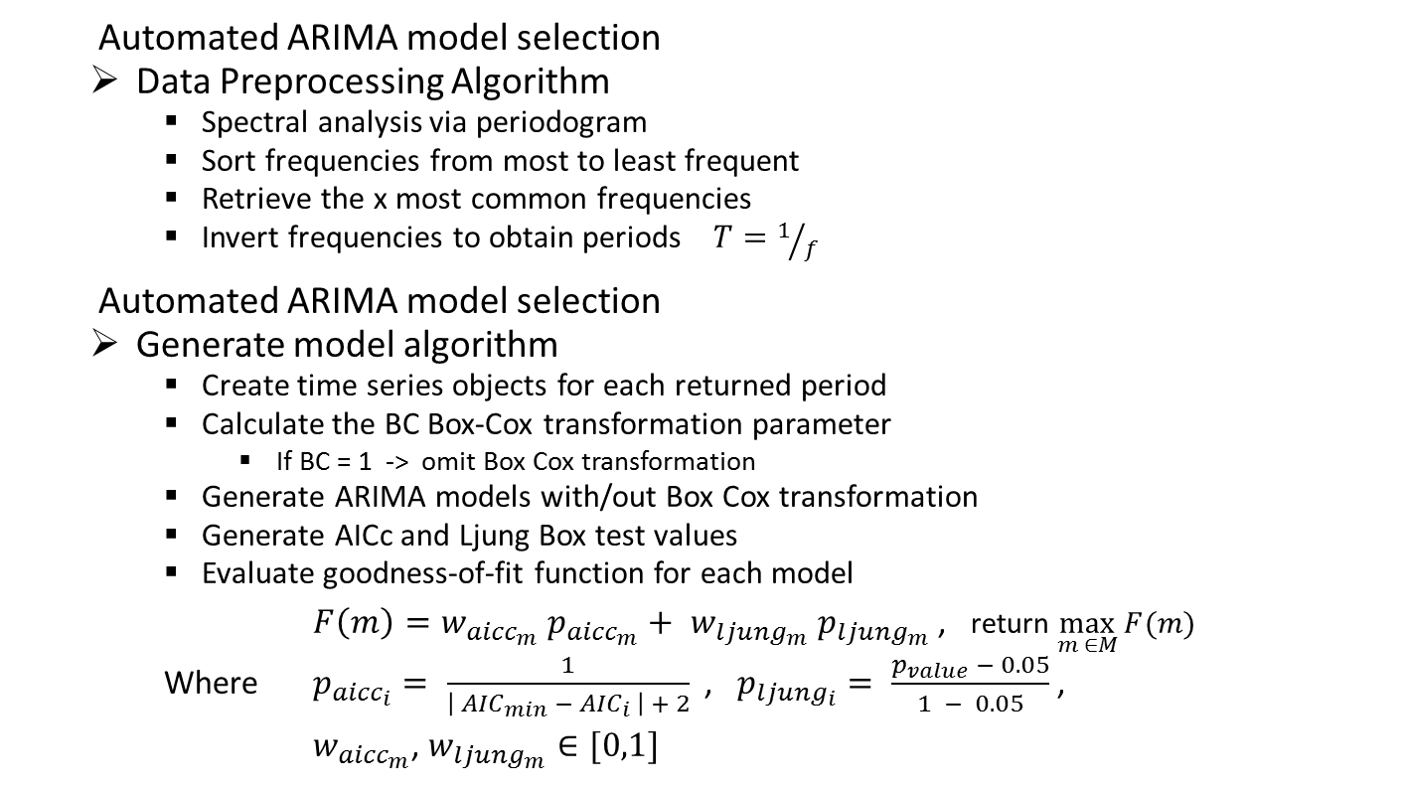
Forecasting
Automated ARIMA model selection
Data Preprocessing Algorithm
Spectral analysis via periodogram
Sort frequencies from most to least frequent
Retrieve the x most common frequencies
Invert frequencies to obtain periods $T=1/f$
Automated ARIMA model selection
Generate model algorithm
Create time series objects for each returned period
Calculate the BC Box-Cox transformation parameter
If BC = 1 -> omit Box Cox transformation
Generate ARIMA models with/out Box Cox transformation
Generate AICc and Ljung Box test values
Evaluate goodness-of-fit function for each model
$F\left(m\right)=w_{{aicc}_{m}} p_{{aicc}_{m}}+ w_{{ljung}_{m}} p_{{ljung}_{m}}$ , return $\max_{m ∈M}{F(m)}$
Where $p_{{aicc}_{i}}= \frac{1}{\left| {AIC}_{min} − {AIC}_{i} \right| + 2}$ , $p_{{ljung}_{i}}= \frac{p_{value} − 0.05}{1 − 0.05}$ ,
$w_{{aicc}_{m}}$, $w_{{ljung}_{m}}∈[0,1]$

Slide 15
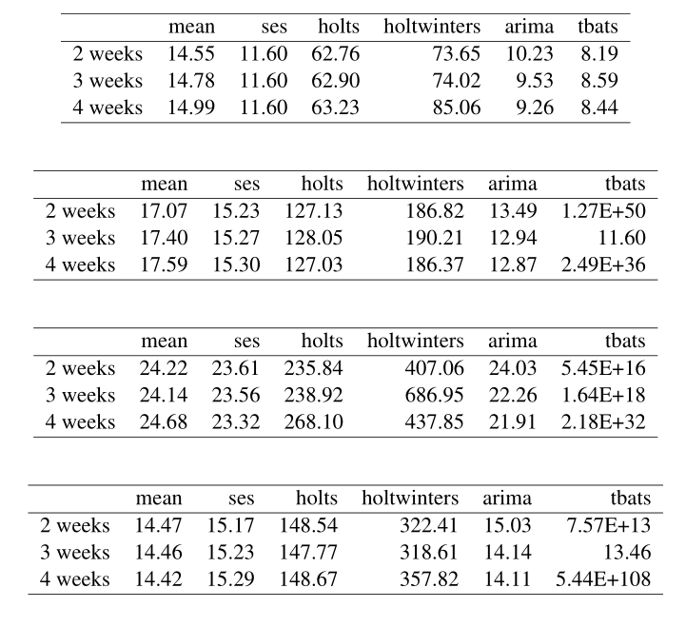
Forecasting
Large scale forecast evaluation – Results
Nord Pool (DA)
Belpex (DA)
ISO-NE (RT)
PJM (RT)
Notes:
Different results based on model and accuracy metric
RMSE, ARIMA -> 2 weeks of trainings data
Forecast horizon with minimal RMSE: 24 hours
Model with minimal RMSE: ARIMA
TODO !! Evaluate results

Slide 16
Simulation Scenario
Definition of simulation parameters
Different types of workload
Uniform distribution over set of values
Server Cores: 4 – 8
Server Memory: 8 – 16
VM Cores: 1 – 4
VM Memory: 1 – 4 GB
VM Durations: 1 / 2 / 5 / 8 / 12 / 24 / 48 hours
VM Dirty page rates: 20 / 40 / 70 / 90 MB/s
Additional parameters
VM SLA availability level: 99.95 %
Penalty costs: 99.00% - < 99.95% -> 10% penalty refund
95.00% - < 99.00% -> 25% penalty refund
< 95.00% -> 50% penalty refund
Bandwidth costs: 0.1 c / GB
Price VM: 0.04 $ / h

Slide 17
Simulation Scenario
Definition of Scenarios
Scenario 1: BFD baseline scheduler
Request assignment: not cost aware, based on load
Migrations: None
Scenario 2: BCU scheduler
Request assignment: cost aware, no forecasts
Migrations: None
Scenario 3: BCU scheduler + FC
Request assignment: cost aware, forecasts
Migrations: None
Scenario 4: BCU scheduler + Ideal FC
Request assignment: cost aware, ideal forecasts
Migrations: None
Scenario 5: BCU scheduler + M
Request assignment: cost aware, no forecasts
Migrations: cost aware, no forecasts
Scenario 6: BCU scheduler + M + FC
Request assignment: cost aware, forecasts
Migrations: cost aware, forecasts
Scenario 7: BCU scheduler + M + ideal FC
Request assignment: cost aware, ideal forecasts
Migrations: cost aware, ideal forecasts

Slide 18
Simulation Scenario
Utility Function
Criteria | Name | Description
c1 | probability of SLA penalty | probability that an SLA penalty will occur after migration (based on experienced downtime)
c2 | estimated migration energy | the expected migration energy depending on VM memory, bandwidth and dirty page rate
c3 | remaining VM duration | number of unit time spans the job or VM is still running
c4 | data center load | investigate current DC loads, focus on load balancing
c5 | estimated cost benefit | expected migration benefit (cost savings) given the current conditions

Slide 19
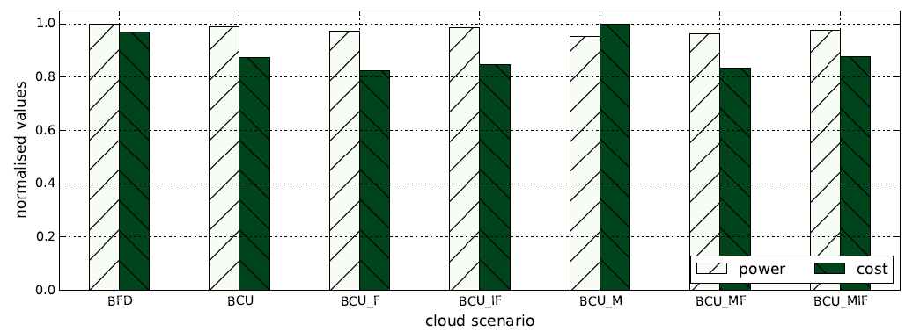
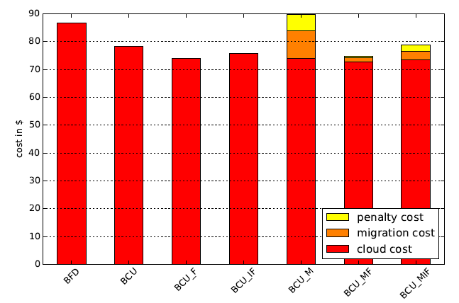
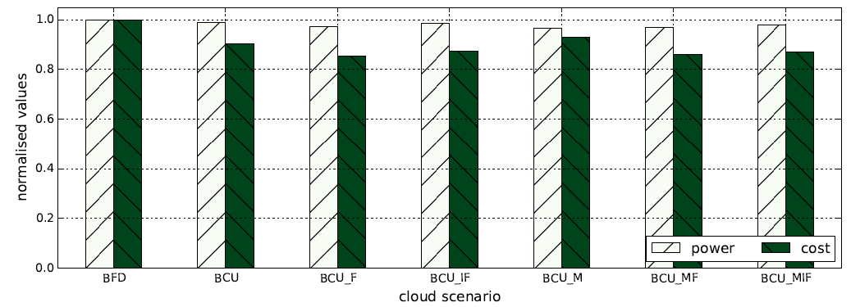
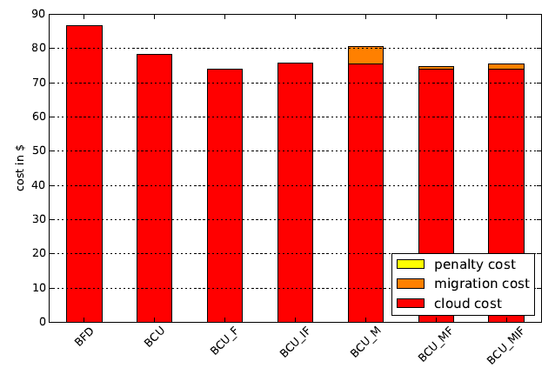
Simulation Results
Evaluate utility function – cost vs best utility
w_sla = 0.3
w_energy = 0.4
w_vm_rem = 0.2
w_dcload = 0.1
w_cost = 1.0
TH = 1.4
w_sla = 1.0
w_energy = 0.1
w_vm_rem = 0.2
w_dcload = 0.1
w_cost = 1.0
TH = 2.0

Slide 20
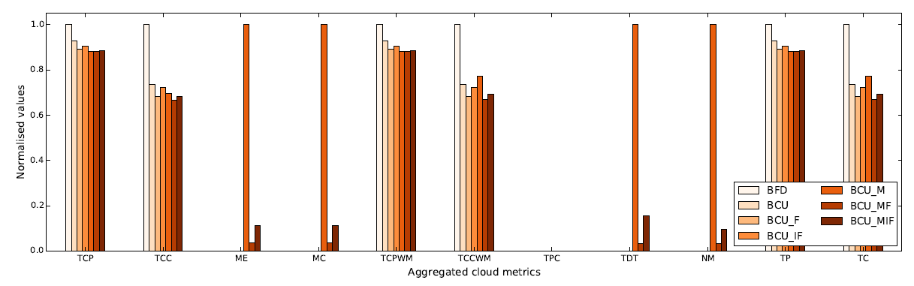
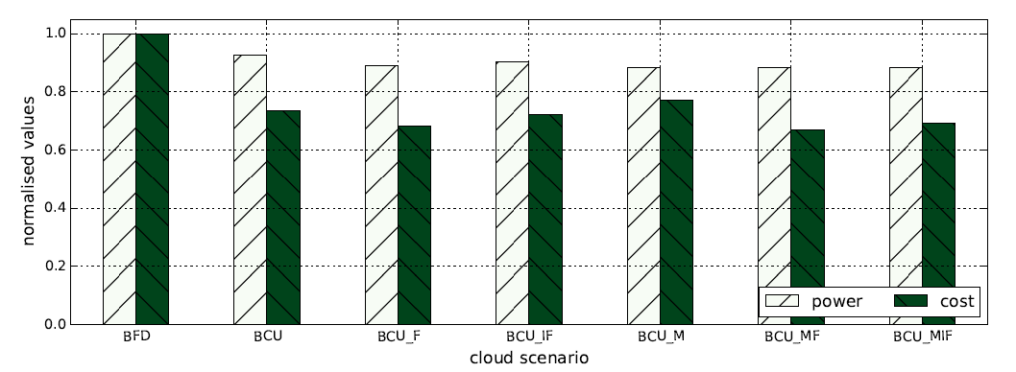
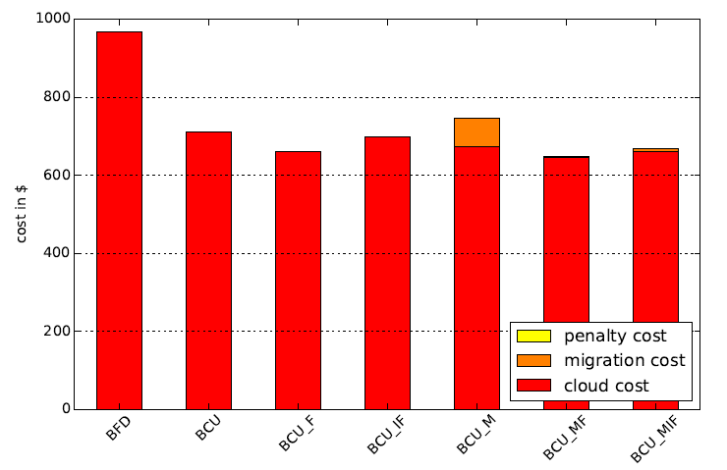
Simulation Results
Simulation „RT Spring“ (4 months 2013)

Slide 21
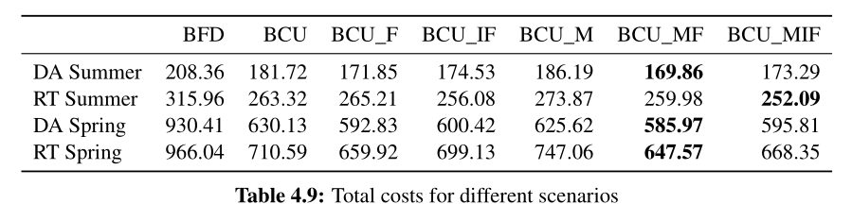
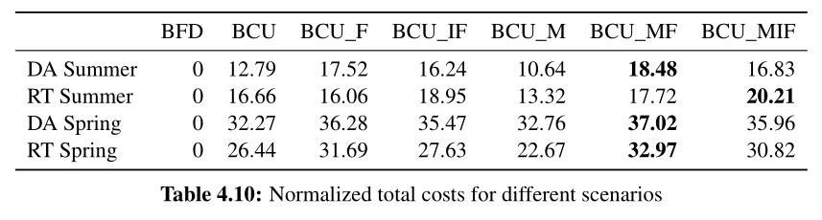
Simulation Results
Aggregated results for all simulations

Slide 22
Conclusion
Results
Significant cost savings for data centers connected to power markets
Promising results for both day ahead and real time markets
Good performance of selected forecast models
Best results for long term simulations
Future Outlook
Selection of additional energy markets and / or time ranges
Include temperature data and cooling costs
Optimize utility function by automatic parameter selection
Evaluate additional forecasting methods
Definition of additional utility criteria
Evaluation for different cloud parameters (bandwidth, dpr, vm price, bw costs)

Slide 23
Bibliography
[1] Google Data Center Efficiency: Measuring Power Usage Effectiveness http://www.google.com/about/datacenters/efficiency/internal/#measuring-efficiency
[2] Data Center World. Data center trends: Optimizing power markets. http://www.datacenterworld.com/fall2013/account/Uploader/uploader_files/show/335/, 2013. Online;accessed 28-February-2016.
[3] Sanjeev Kumar Aggarwal, Lalit Mohan Saini, and Ashwani Kumar. Electricity price forecasting in deregulated markets: A review and evaluation. International Journal of Electrical Power & Energy Systems, 31(1):13–22, 2009.

Slide 24
Thank You for Your Attention

